Slide 1
CAPM

Slide 2
The concept of Capital Asset Pricing Model (CAPM) was introduced by Jack Treynor, William Sharpe, John Lintner & Jan Mossin.
The CAPM is a model that describes the relationship between the expected return & systematic risk of an asset (particularly stocks).
[Systematic risk refers to the risk inherent to the entire market. Systematic risk, also known as “undiversifiable

Slide 3
risk,” that affects the overall market, not just a particular stock or industry. This type of risk is impossible to avoid.
It shows that the expected return on a security is equal to the risk-free return plus a risk premium, which is based on the beta of that security.

Slide 4
The formula for CAPM:
E(R) = R_{f} + β (R_{m} – R_{f})
where,
E(R) = Expected return on a security
R_{f} = Risk free rate
β = Beta of the security
R_{m} = Return of the market
R_{m} – R_{f} = Risk premium

Slide 5
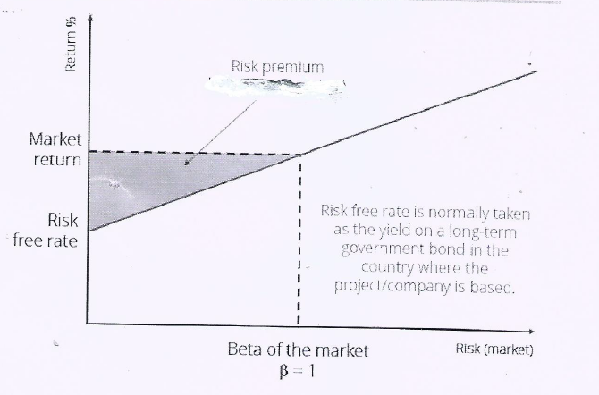
Fig. 4 : CAPM

Slide 6
Risk-free Rate
The risk-free rate is the return on a security (or a portfolio of securities) that is free from the default risk & is uncorrelated with returns from anything else in the economy. (Treasury bill , Govt. bonds)

Slide 7
Market Risk Premium
The market-risk premium is the difference between the expected return on a market portfolio & the risk-free rate.

Slide 8
Beta:
Beta is a measure of a stock’s volatility in relation to the overall market. By definition usually markets have a beta of 1
A stock that swings more than the market over time has a beta of over 1 & vice versa.
High-beta stocks are supposed to be riskier but provide higher return potential & vice versa.

Slide 9
The beta of a stock is 0.6 which implies that a stock’s movement will theoretically be about 60% of the index’s movement.
By multiplying the beta value of a stock with the expected movement of an index, the expected change in the value of the stock can be determined.

Slide 10
For e.g., if beta is 1.4 and the market is expected to move up by 10%, then the stock should move up by 14% (1.4 x 10).
[Volatility is a rate at which the price of a security increases or decreases for a given set of returns.]

